Slide 1
APPLICATION FOR THE VISUALLY IMPAIRED PEOPLE
PROJECT MEMBERS PROJECT GUIDE
V . Hemalatha (211413205035) Ms . S. Kumari
B . Harita Chandini (211413205034) Assistant Professor

Slide 2
Abstract
The sole intention behind the consideration of this project is to reduce the complexity of visually impaired people in reserving tickets .
There are many types of hurdles during the reservation in ticket system for visually impaired people. At present the current ticketing systems are not mature enough to work for visually impaired users.
With the invent of online reservation system for visually impaired ,they can book a seat anywhere at any time at their convenience which reduces the complexity and makes them feel independent .
The traveller can book their ticket through toll free number which saves the money and time for the travelling.
Since the system uses OTP number as a secret code it also becomes a hassle free transaction for both the traveller and railway reservation board

Slide 3
Literature Survey
S. No | Name of the paper with year | Objective | Pros | Cons
1 | Object Recognition in Mobile Phone Application for Visually Impaired Users was developed at 2015 | To enable the visually challenged to access visualizations such as images, objects, information in the form of text etc. | Easy to use | Connectivity problems of devices
2 | Websites to support the visually impaired was developed at 2009 | To find out how websites should be designed to function well with aiding devices of visually impaired person | Understandable operable and interactive | Supports only text and audio format

Slide 4
3 | A new Android application for blind people was developed at 2016 | To help the visually impaired person to operate smart phones easily . | It enables them to call, text and also helps in positioning or battery monitoring, through voice commands | Does not work properly when the word is misspelled during speech recognition
4 | An Assistive reading system for visually impaired using OCR and TTS was developed at 2014 | Digital information in text are converted to voice | Provides good GUI between blind people and system . | Cannot convert images to voice format
5 | Ticket vending machine for visually impaired was developed at 2010 | To make the process of getting ticket easy by buying ticket at their own from the ticketing machine | Easily operable | This machine is not located in care centers . Disconnectivity between devices

Slide 5
Existing System
In the existing system, there are no applications developed to aid visually impaired people based on traveling and ticketing. If they want to travel by train , they have to wait for a long time to get a ticket and are assisted by someone .
This makes them feel dependent and is a time consuming process. In case they miss the tickets, they couldn’t get another ticket. In such situation they have to pay penalty to the Travelling Ticket Examiner .

Slide 6
Disadvantages
In the existing system they have to spend more time to get the tickets.
They have to stand in long queue to get their tickets.
Alternate tickets cannot be purchased if the ticket is misplaced
They need to be assisted by someone to get their tickets

Slide 7
Proposed System
In the proposed system, we develop an application to rectify the problems in the existing system.
With the smart PHP app the blind people can easily get the tickets anytime and anywhere.
The tickets are in the format of OTP. They get their OTP by calling the admin and informing the source and destination detail. Through this it is made easy for the blind people to travel in train.
The main objective of this app is to help the blind people in their traveling .
To assist the blind people and make their ease of traveling by issuing the single OTP to the user.

Slide 8
Through this they can easily get the ticket by the phone call at anytime and anywhere.
To reduce the effects and difficulties in getting the tickets while traveling from one place to another place for the blind peoples.
The work flow of our project is as follows: Our project contains two users namely admin and the blind people.
Former, the blind people register their unique aadhaar card number .
The aadhaar number which is provided is unique for each user.
They have to register with that unique number and mobile number at first. On the other side the admin monitors all the blind people details.
If the user wants to get a ticket , they have to call to the toll free number.
After that the user should mention the source and destination location of their travel and the time and date of the travel. Based on the user details given, the admin generates the OTP for that particular user.

Slide 9
The generated OTP is shared with the user. The OTP is sent to the user’s mobile number .
When they travel, they have to show the OTP to the ticket checker. The ticket checker verifies that the ticket is valid or not. After getting the OTP from user, they submit the OTP to the server.
After submitting it to the server , it returns the full traveling details of the user.
The details contain the source ,destination , time and date of the travel with thier unique aaadhaar number .
With the help of this app the blind people get the tickets easily. Also the waiting time to get the ticket is reduced. Hence it is ensured that this is the useful for the visually impaired people .

Slide 10
Advantages
In proposed system, it is made easy for the visually impaired people to get their tickets using the OTP issued to them.
As the ticket is in the OTP format sent to their mobile number , there are no chances of missing the tickets.
More secure system
This also reduces the people effort in getting thier tickets.
They can book their tickets independently without any personal assistance .

Slide 11
Novelty
The main novelty of this app is to help the visually impaired in reserving a ticket independently without any assistance .
To assist the blind people and provide them ease of travel by issuing the single unique OTP to the user.
Through this they can easily get the ticket by a phone call

Slide 12
Feasibility Study
COST
The firm will be able to build such a system with low cost . Since this system is created as a web application, it requires less investment from user.
PERFORMANCE
Since most projects developed for visually impaired person are complex in terms of performance . This system was mainly developed to address these complexities. There are many navigation systems developed for the visually impaired people but such systems have connectivity problems. This system overcomes the connectivity problems since the reservation of tickets are done by calling a toll free number anywhere and anytime
DESIGN
Since PHP application is used more attractive colors are implemented in the design of the application which helps people with low vision to interact easily

Slide 13
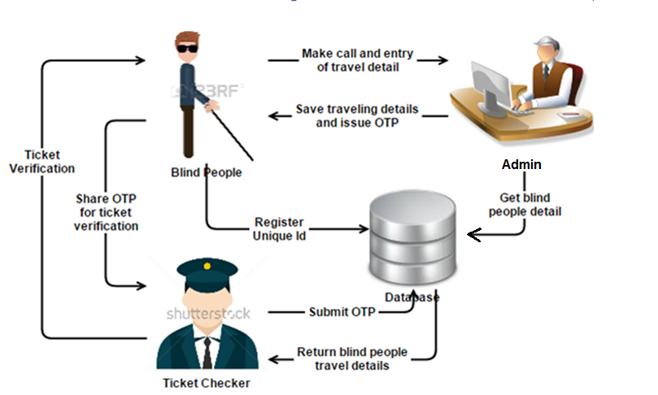
Architecture Diagram

Slide 14
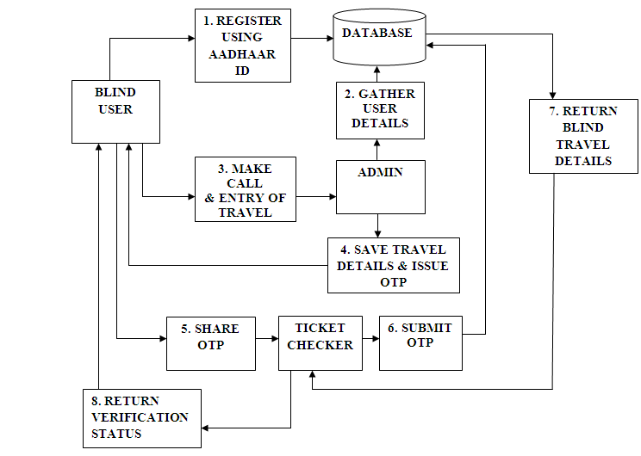
Dataflow diagram

Slide 15
System Requirements
SOFTWARE REQUIREMENTS:
Operating system : Windows
Technology Used : PHP 4.2
IDE : Dreamweaver
Database : My SQL
Tools used : PHP Studio , NVDA
HARDWARE REQUIREMENTS:
Processor : Pentium P4
Motherboard : Genuine Intel
RAM : Min 1 GB
Hard Disk : 80 GB
Mobile : PHP Based Smart phones

Slide 16
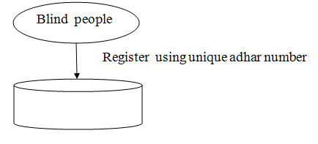
Modules Description
Unique Id registration and login
The blind people register in the php application using unique aadhaar id . The aadhaar number provided by each user is unique and the user also registers his / her mobile number in the database . The blind user can login into his/her account using the unique Aadhaar number provided during registration.

Slide 17
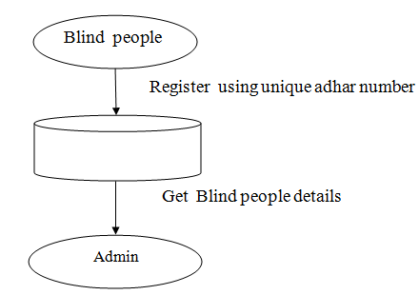
Get blind people details
The admin gathers the necessary details of the registered user using the unique number provided by the visually impaired person . The information are gathered from the database which stores all the details of the registered user .

Slide 18
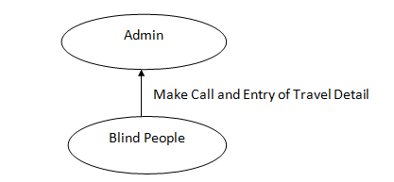
Travel detail entry
The user can reserve tickets by just calling a toll free number . By making a call , the travel details like the source , destination , date and time of travel are provided by the user to the administrator .

Slide 19
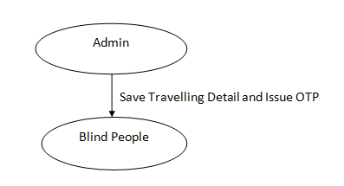
Issue OTP
Based on the details given by the user in the call , the admin generates the OTP for that particular user. The user details with the generated OTP is saved into the database. Also the generated OTP is shared with the user. The OTP is sent to the user’s mobile number .

Slide 20
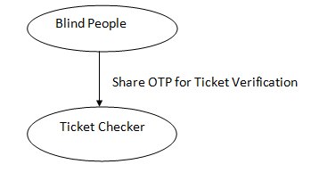
Submit OTP
When they travel, the visually impaired person needs to show the generated OTP to the Ticket Checker for verification.

Slide 21
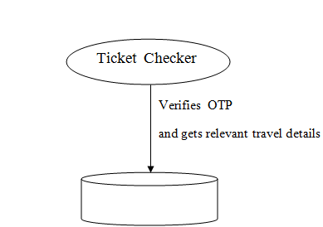
Ticket Verification
The ticket checker verifies that the ticket is valid or not. After getting the OTP from the user, they submit the OTP to the server. After submitting it ,the server returns the full travel details of the user to the Ticket Checker . The details contain the source , destination ,time and date of the travel with the unique aadhaar number id .

Slide 22
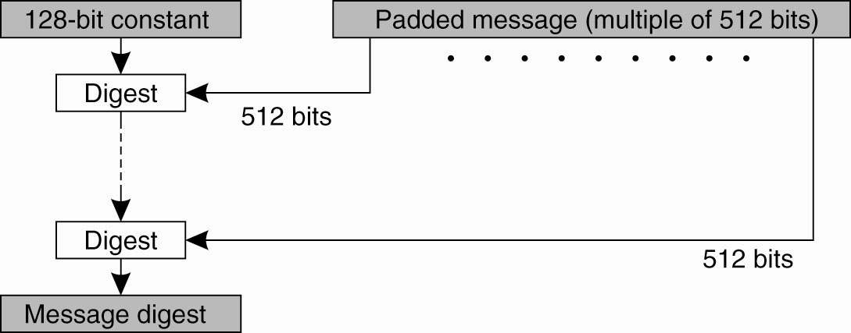
Algorithm Used
MD 5 is used to encrypt the details provided by the visually impaired user

Slide 23
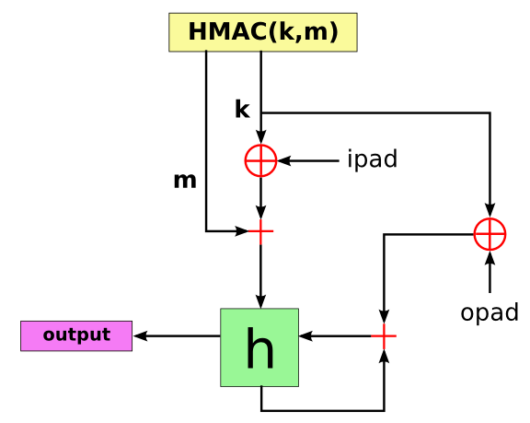
HMAC is used to generate unique OTP numbers to the registered user

Slide 24
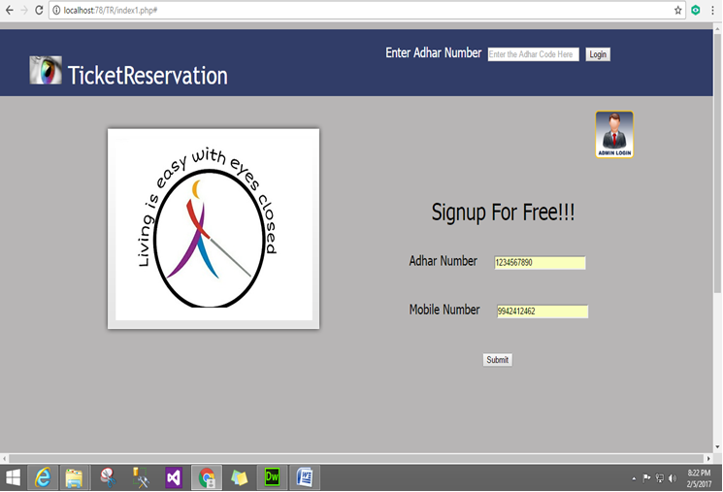
Unique ID Registration

Slide 25
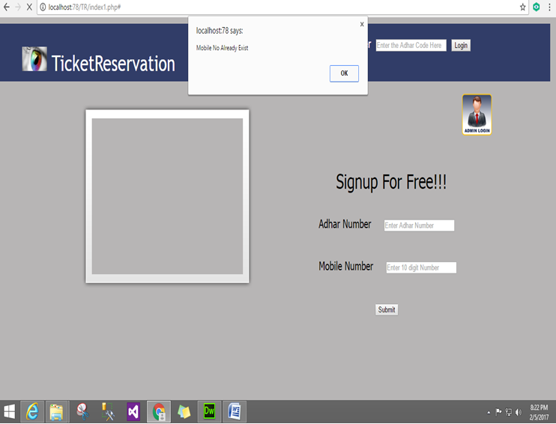

Slide 26
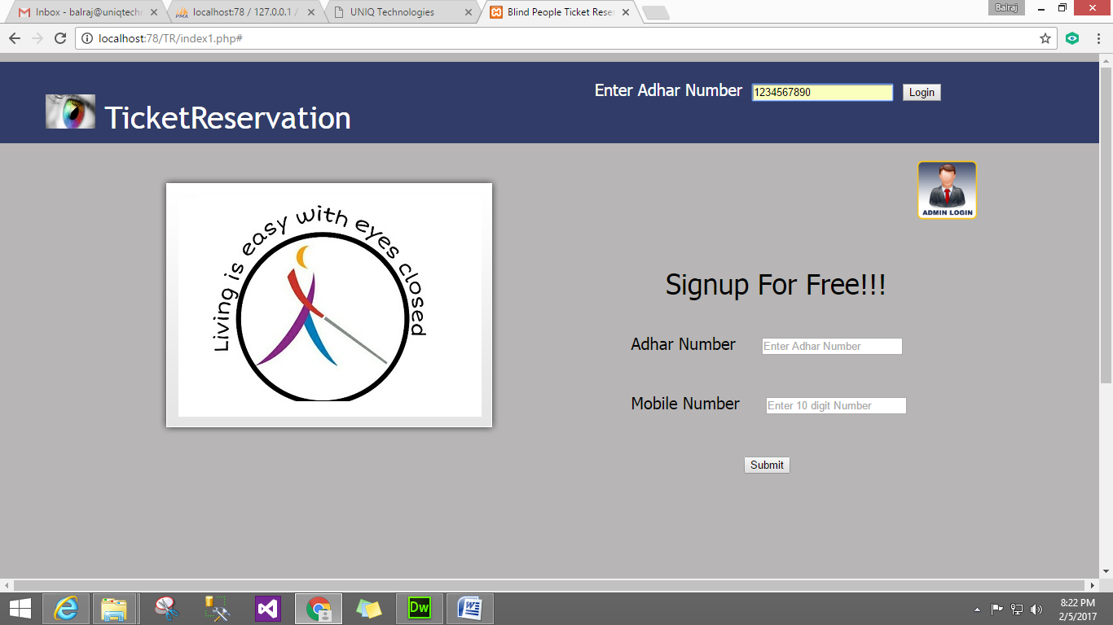
Login

Slide 27
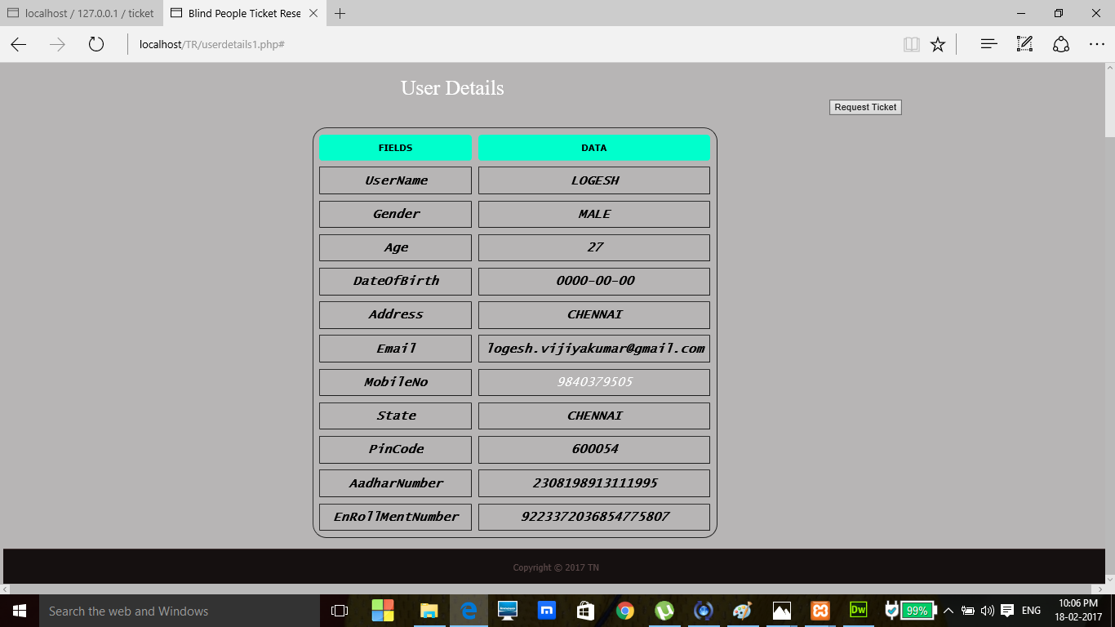
User details

Slide 28
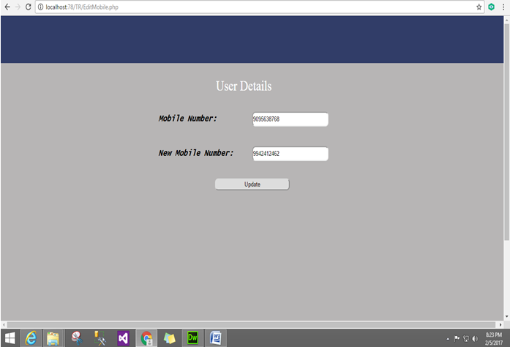
Mobile number modification

Slide 29
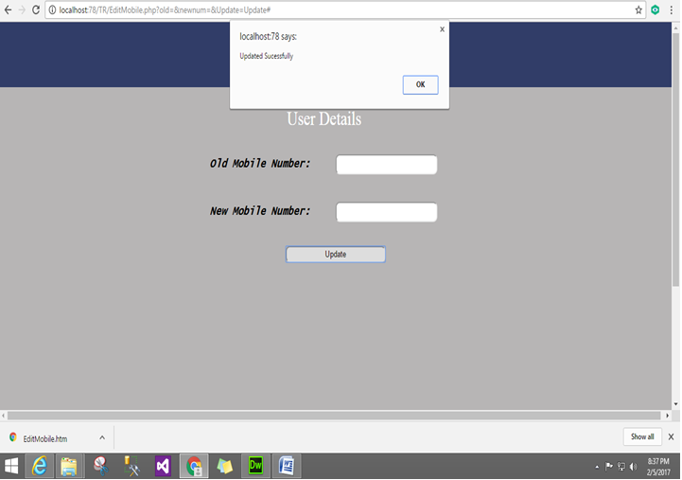

Slide 30
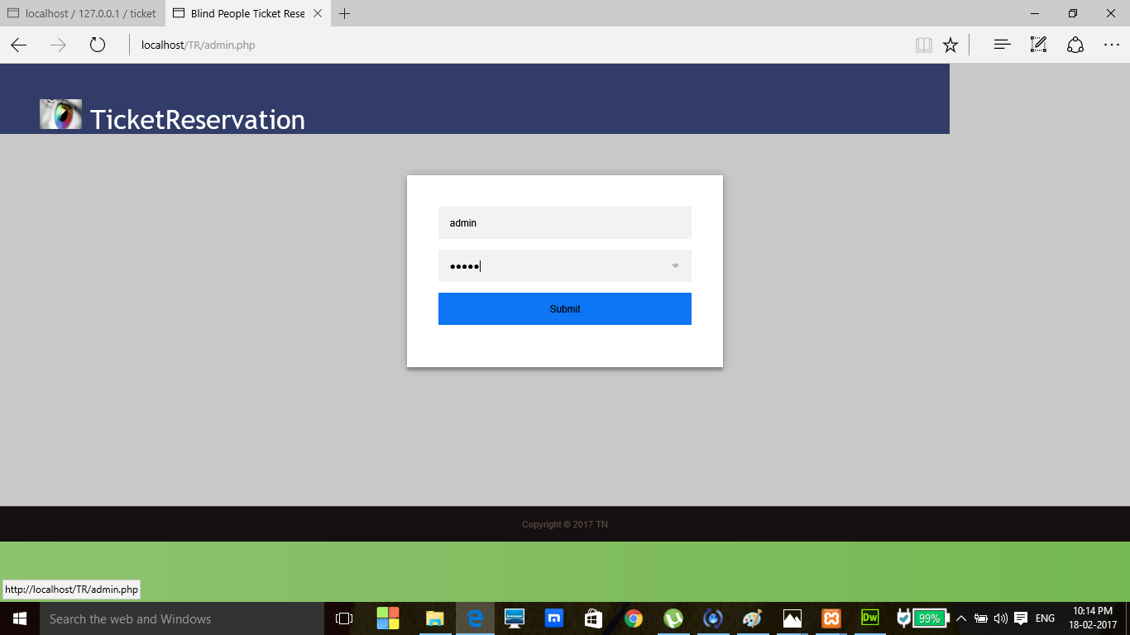
Admin Login

Slide 31
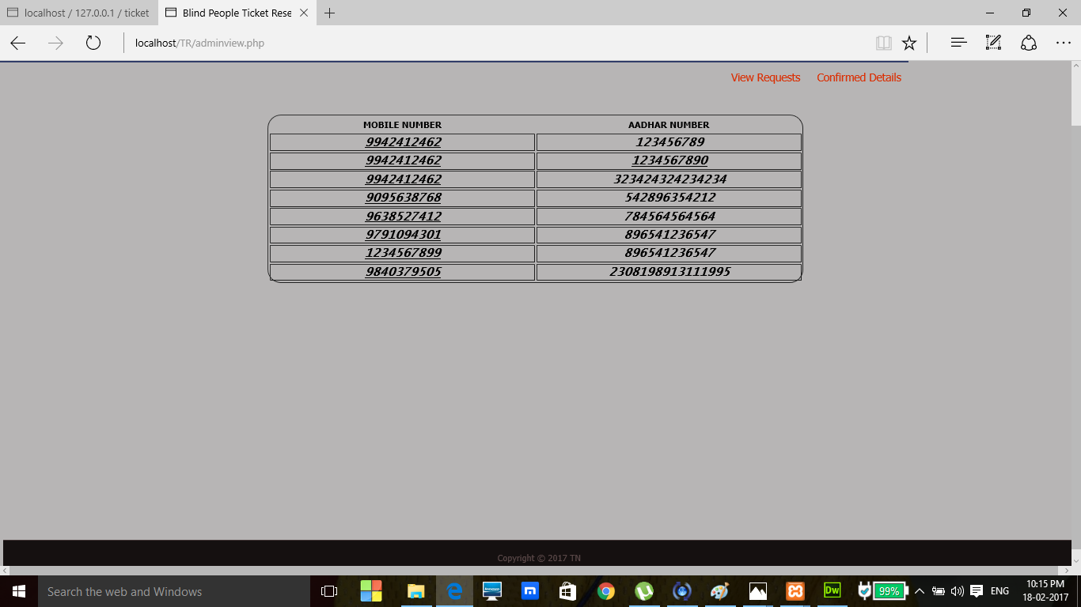
Get user details

Slide 32
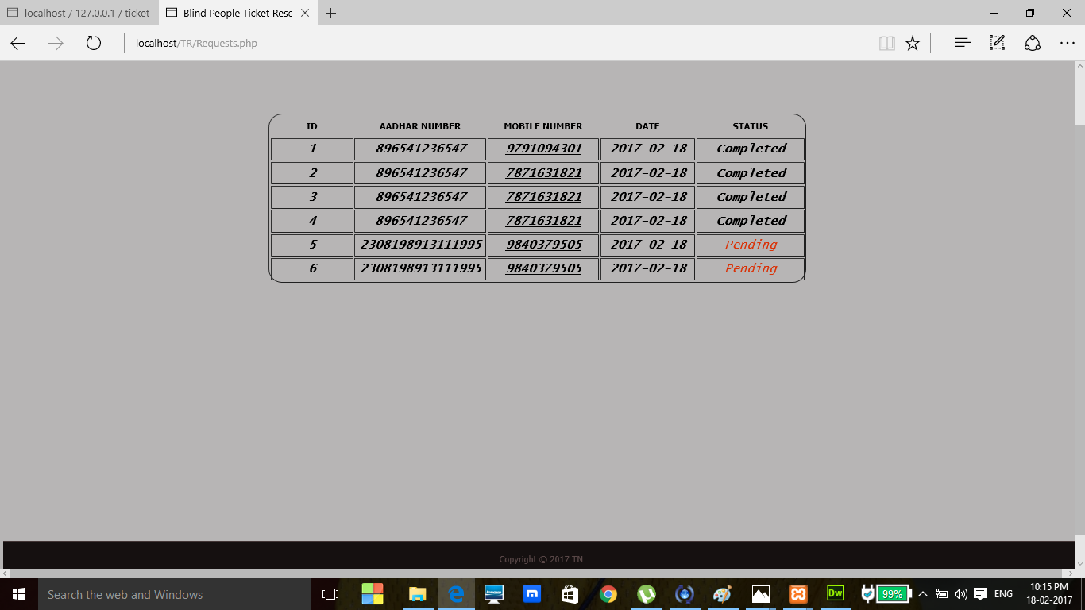

Slide 33
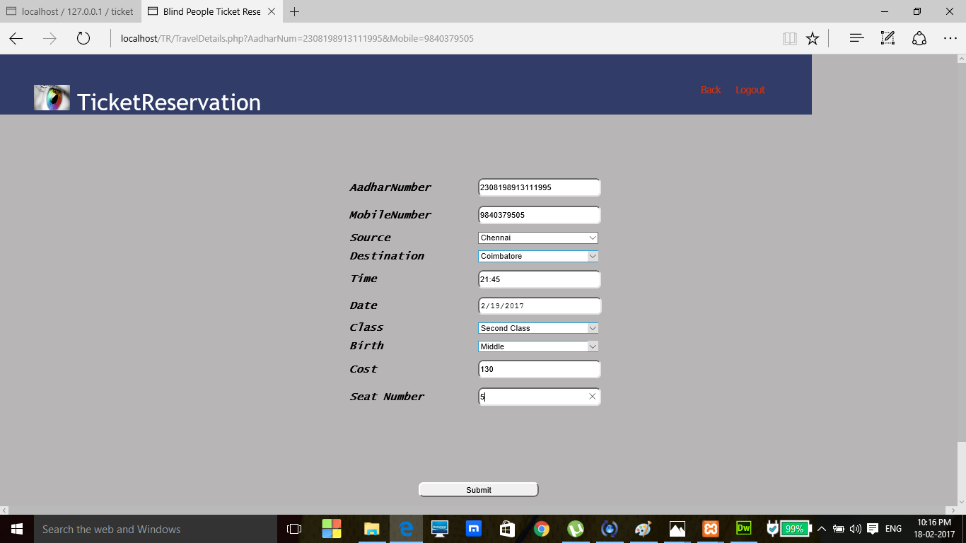
Get travel details

Slide 34
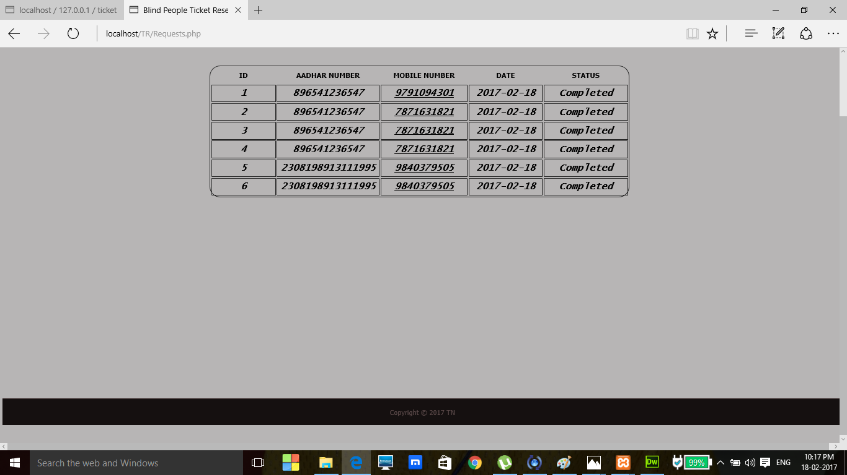

Slide 35
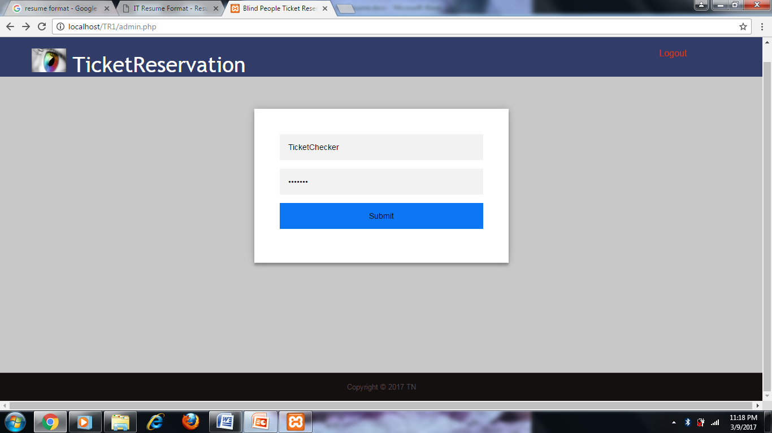
Ticket checker verification

Slide 36
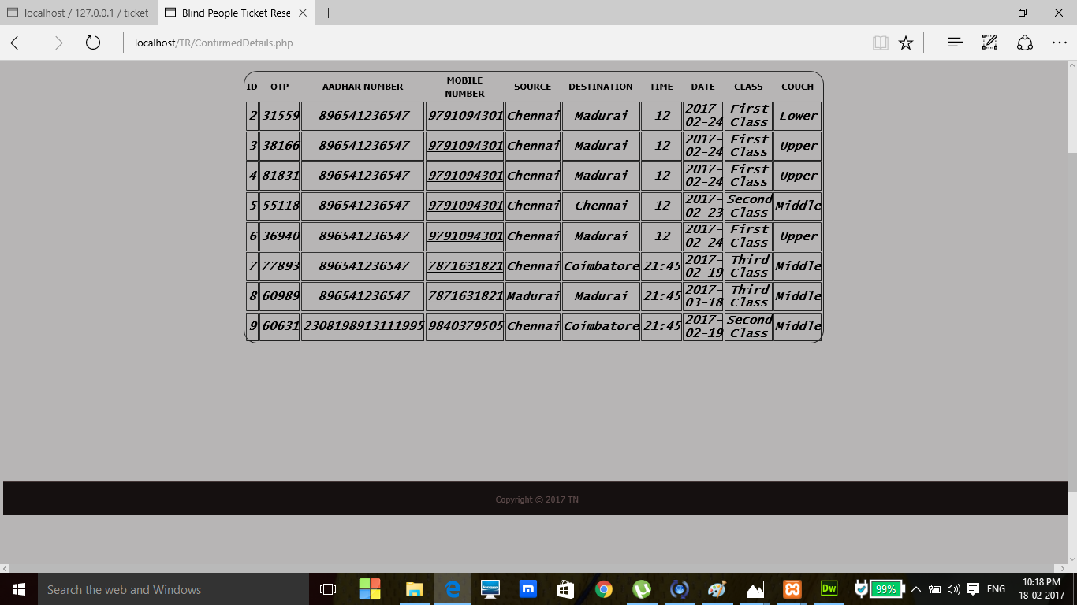

Slide 37
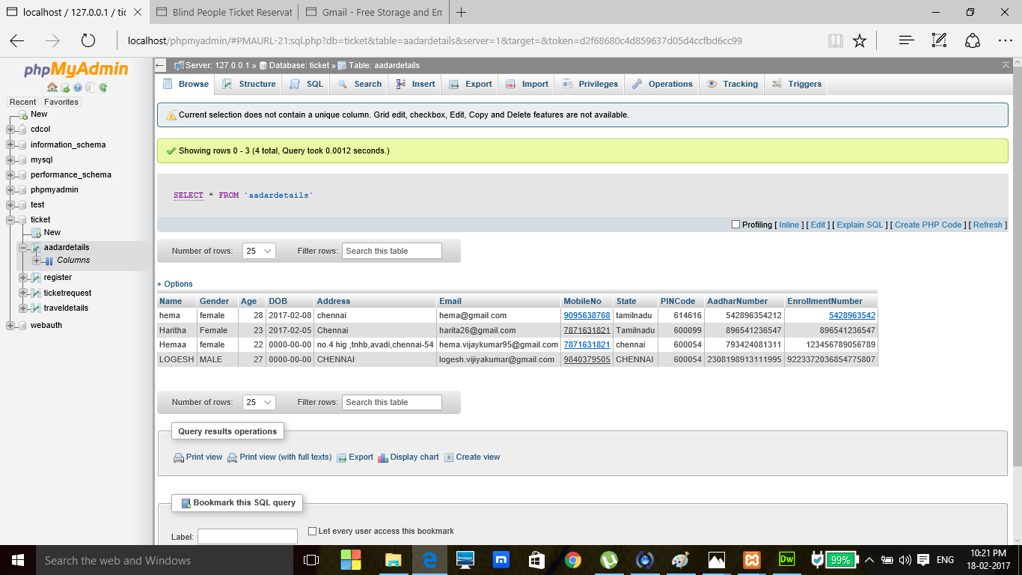
MySQL server

Slide 38
Project work flow
Total number of modules : 6
Total number of modules completed : 6
Time span for module completion : 4 weeks
Modules yet to be completed : 0

Slide 39
References
Adam Dąbrowski, Damian Huderek, Marcin Iwanowski, Piotr Kardyś, “A new android application for blind and visually impaired people”, IEEE Transaction on Computers, Poland 2016.
R. Guha, V. Gupta, V. Raghunathan, R. Srikant, “User modeling for a personal assistant”, The 8th WSDM International Conference, Shanghai 2015.
S. M. Kulkarni, Rupa N. Digole, ”Smart navigation system for visually impaired person”, International Journal of Advanced Research in Computer and Communication Engineering, India 2015.
Pooja Sharma, Shimi S. L, “Design and Development of Virtual Eye for the blind”, International Journal of Innovative Research in Electrical, Electronics, Instrumentation and Control Engineering, India 2015.
J. Hildenbrand, “What is Google TalkBack”, AndroidCentral.com, 2014.

Slide 40
Bairoju Vishwa Rupa Chary, B.Santosh Kumar, “Rescue system for visually impaired blind persons”, International Journal of Engineering Trends and Technology (IJETT), India 2014.
Harshad Girish Lele, Mrunmayi Mohan Modak, Viten Vilas Lonkar, Varun Vasant Marathe, “Electronis path guidance for visually impaired people”, The International Journal Of Engineering And Science (IJES), India 2013.
Abhishek Srivastava, Adhar Vashishth, Akshay Sharma, “An assistive reading system for visually impaired using OCR and TTS”, International Journal of Computer Applications, India 2014.
L. Katz, “Ray turns Android phone into device for the blind”, Cnet.com, 2012.
Amanda Hastings, Ravi Kuber, Matthew Tretter, “Determining the accessibility of mobile screen readers for blind users”, IASTED Conference on Human-Computer Interaction, Baltimore, USA 2012.
A. Ruthruff, “How to use Voice Dialer on an Android phone”, Groovy Post LLC, Port Orchard 2010.

